Slide 1
PSO fails and CNN introduction
Louis, Sweta, Albert

Slide 2
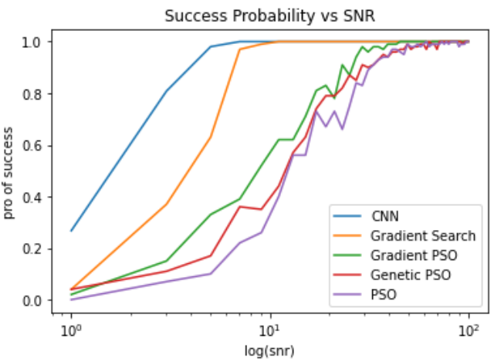

Slide 3
PSO and PSO-optimized
Traditional PSO
Velocity update: new_v = previous_v + personal_v + global_v
Genetic PSO
In each iteration, some particles that perform bad might die
In each iteration, some new particles might be generated from two particles that perform well in last iteration
Instead of regard the global best position or final average position of all particles, use the average position of 6 highest intensities in history as the output of GPSO
Gradient PSO
Velocity update: new_v = gradient * learning rate + personal_v + global_v
Gradient = (intensity right now – last intensity) / (position right now – last position)

Slide 4
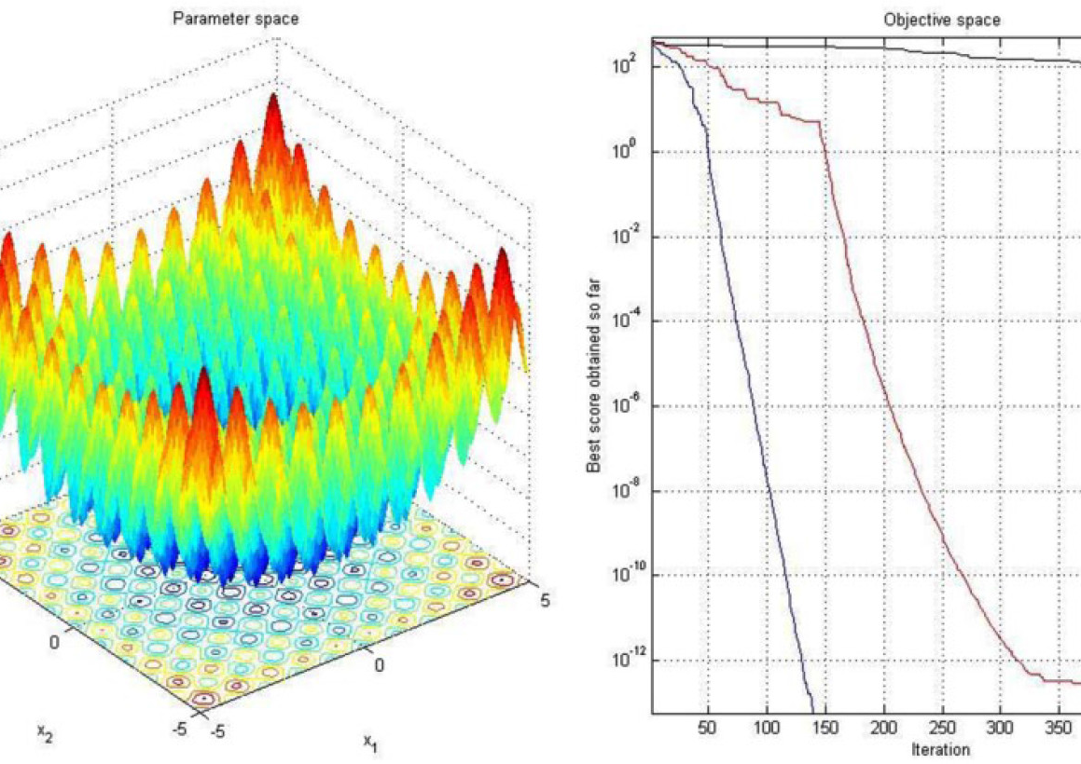
Why PSO fail?
Target : find the maximum location in a noisy unimodal function
What PSO is good at? --- find the maximum location in (noisy) multimodal function by personal best and global best

Slide 5
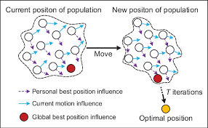
Why PSO fail?
How does PSO handle the noise?
Noise influence = Noise influence of PSO / #particles
Neither global best nor personal best does nothing helpful for extremely noisy function

Slide 6

Born in mass, die in noise

Slide 7
How CNN work?
Generate training data and test data
10000 training data and 10000 testing data
In each example:
Random SNR between 0.1 and 100(training) & SNR between 1 and 1000(testing)
Random maximum location in the cube from (-1,-1,-1) to (1,1,1)
1000 data points
Build and train the model
X is intensities of each 1000 data points
y is location of maximum
Predict the test data and assessment
If the distance(predict,real)<0.225, then successful

Slide 8
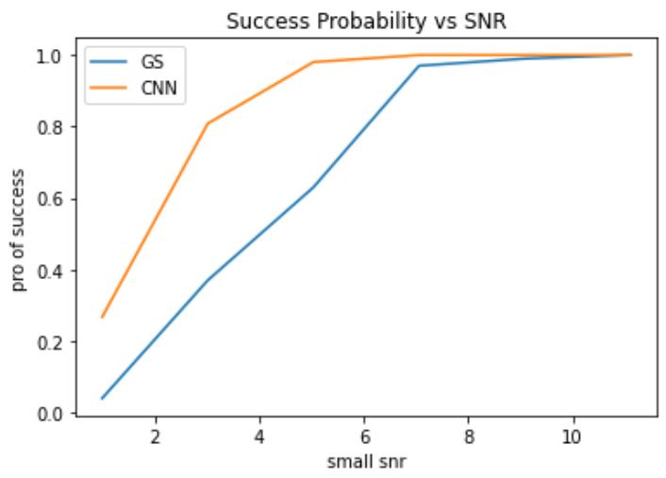
How CNN perform in small SNR
Notes that it might be unfair for CNN because the definition of success is different

Slide 9
Why CNN works?
Learn through whole domain
CNNs use convolutional layers to detect local features in the input data, allowing them to capture spatial dependencies between adjacent pixels.
CNN is not sensitive to noise
CNNs can be trained to learn robust representations of noisy data, by using techniques such as regularization and dropout to prevent overfitting and improve generalization.

Slide 10
Exploring experience
January-----Use CNN to fit function---stupid
February----PSO
3.10--------Genetic PSO--------------------better than PSO
3.12--------Bayesian Optimization---successful when SNR =200
3.15--------Gradient PSO-------Gradient + Swarm Intelligence?
3.17--------Use CNN to build model---------not yet optimized

Slide 12
Next step
Implement CNN in lab
Using theory training data in reality
Optimize CNN
---LM-fit---compared with----PSO and CNN
Normalize training and testing
Predicting using less data points
Change the iteration of Gradient search
Optimize CNN

